Slide 1


socio-economic Factors That influence the distribution and availability of Electric Vehicles charging stations in various counties
Pradhi Kohli
Nov 17, 2024
University of South Alabama

Slide 2
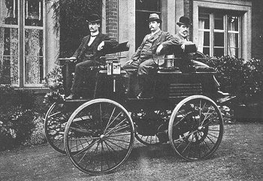
History
Early Development (1800s): Electric vehicles began
First Electric Car (1890): US, William Morrison introduced EV
Peak Popularity (1900): Electric cars accounted for about a third of all vehicles on the road (taxis).
Competition with Gasoline Cars (1908-1914): The introduction of Henry Ford’s mass-produced Model T (1908) made gasoline cars affordable ($650), impacting electric car sales ($1750).
Decline of Electric Vehicles (1935): By the mid-1930s, EVs nearly vanished due to cheap gasoline, and better road.
electric vehicle built by an English inventor in 1884.
https://www.energy.gov/articles/history-electric-car

Slide 3
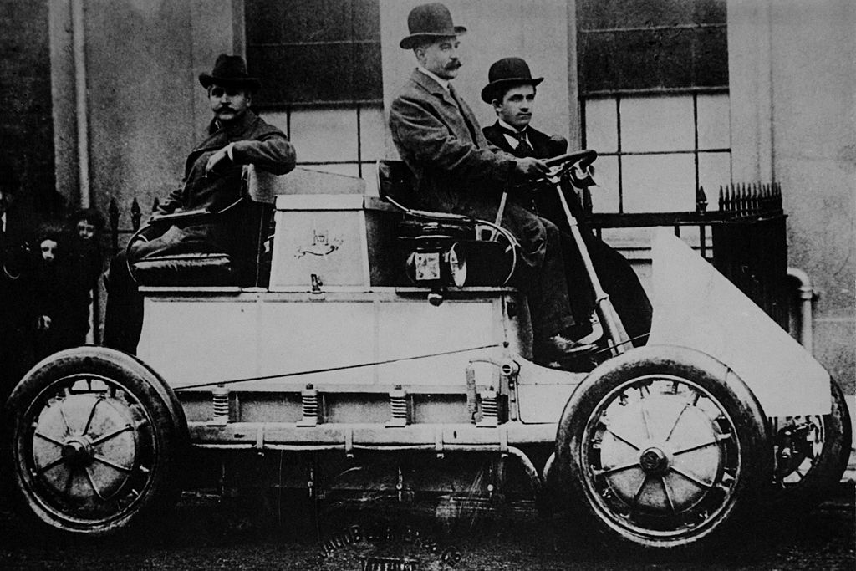
History (cont.)
Interest Renewed (1970s): The 1973 Arab Oil Embargo and rising oil prices led to renewed interest in EVs.
Regulatory Changes (1990s): Clean Air Act Amendment and California emissions regulations reignited interest in EVs,.
New Technologies (2000s): Launch of the Toyota Prius (1997) and Tesla's luxury electric sports car (2006), significant milestones.
Infrastructure Investment (2010s): The U.S. government invested in charging infrastructure; over 20,000 charging outlets.
Future Potential (2012-Present): Goverment aims to make EVs as affordable as gasoline cars, targeting a significant reduction in oil dependence and carbon emissions.
World's First Hybrid Electric Car 1901

Slide 4
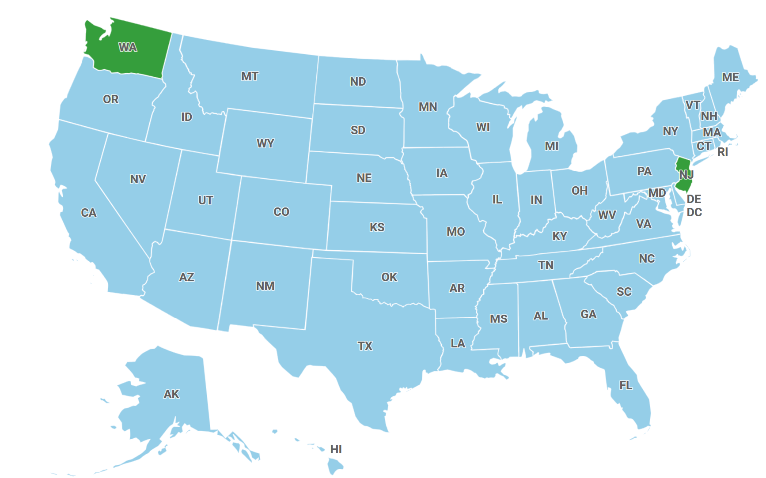
US Map
Unit of Analysis: Counties in USA
Counties: WA - 39
Counties: NJ - 21
Data fron year 2020 to 2022
DV: availability of charging stations
Predictors (IV): EV population, increased per capita income, larger population estimates, and lower unemployment rate
Washington is about 9 times bigger than New Jersey.
New Jersey is 8.9% more expensive than Washington.
https://www.mylifeelsewhere.com/cost-of-living/washington-usa/new-jersey-usa
https://www.fla-shop.com/visited-states/?st=NJ%2CWA&vc=1ca032&uc=90cfea&hc=40bfa6&bc=ffffff&sl=on

Slide 5
RQ and Hypothesis
Electric vehicle (EV) charging stations are essential for supporting the widespread adoption of electric vehicles (EVs). Easily accessible charging options help alleviate range anxiety for drivers. However, EV charging infrastructure is unevenly distributed
RQ: How do county’s selected socio-economic variables - ev population, per capita income, population estimates, and unemployment rates – from 2020 to 2022 influence the distribution and availability of charging stations in various counties?
Hypothesis: Higher ev population, increased per capita income, larger population estimates, and lower unemployment rate are positively associated with a greater distribution and availability of charging stations, across various counties from 2020 to 2022.

Slide 6
Data Description
Panal Data from counties in WA and NJ states.
Year 2020 – 2022
Sample size 180
Excel is used to organize, clean, and combine data from four distinct sources: AFDC (Alternative Fuels Data Center), BEA (Bureau of Economic Analysis), atlasweb, ERS (Economic Research Service)
Python programming language: perform Exploratory data analysis and Descriptive Statistics analyses and visualizations: histograms and scatter plots

Slide 7
Descriptive Statistics
 | Unemployment Rate | Population Estimate | Per capita personal income | EV registered | EV charging stations
count | 180 | 180 | 180 | 180 | 180
mean | 6.721111 | 283627 | 61567.37 | 4520.939 | 93.72778
std | 2.248798 | 376020.9 | 16043.96 | 21668.27 | 257.4603
min | 3 | 2294 | 42484 | 2 | 0
25% | 5.1 | 44126.5 | 50278.75 | 216.5 | 10
50% | 6.4 | 110958.5 | 57010.5 | 983.5 | 34.5
75% | 8.325 | 475910.3 | 66959 | 2945.25 | 92.75
max | 17.1 | 2274282 | 113819 | 279119 | 2109

Slide 8
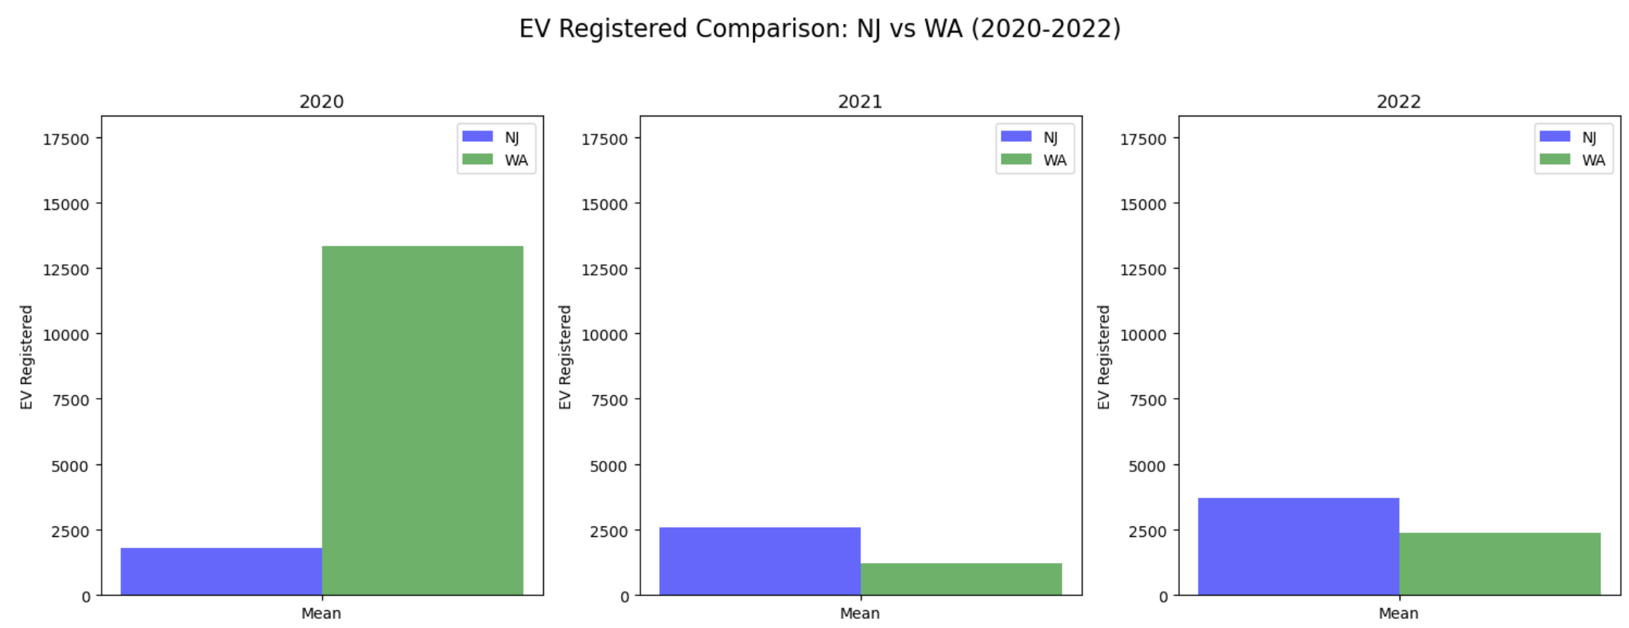
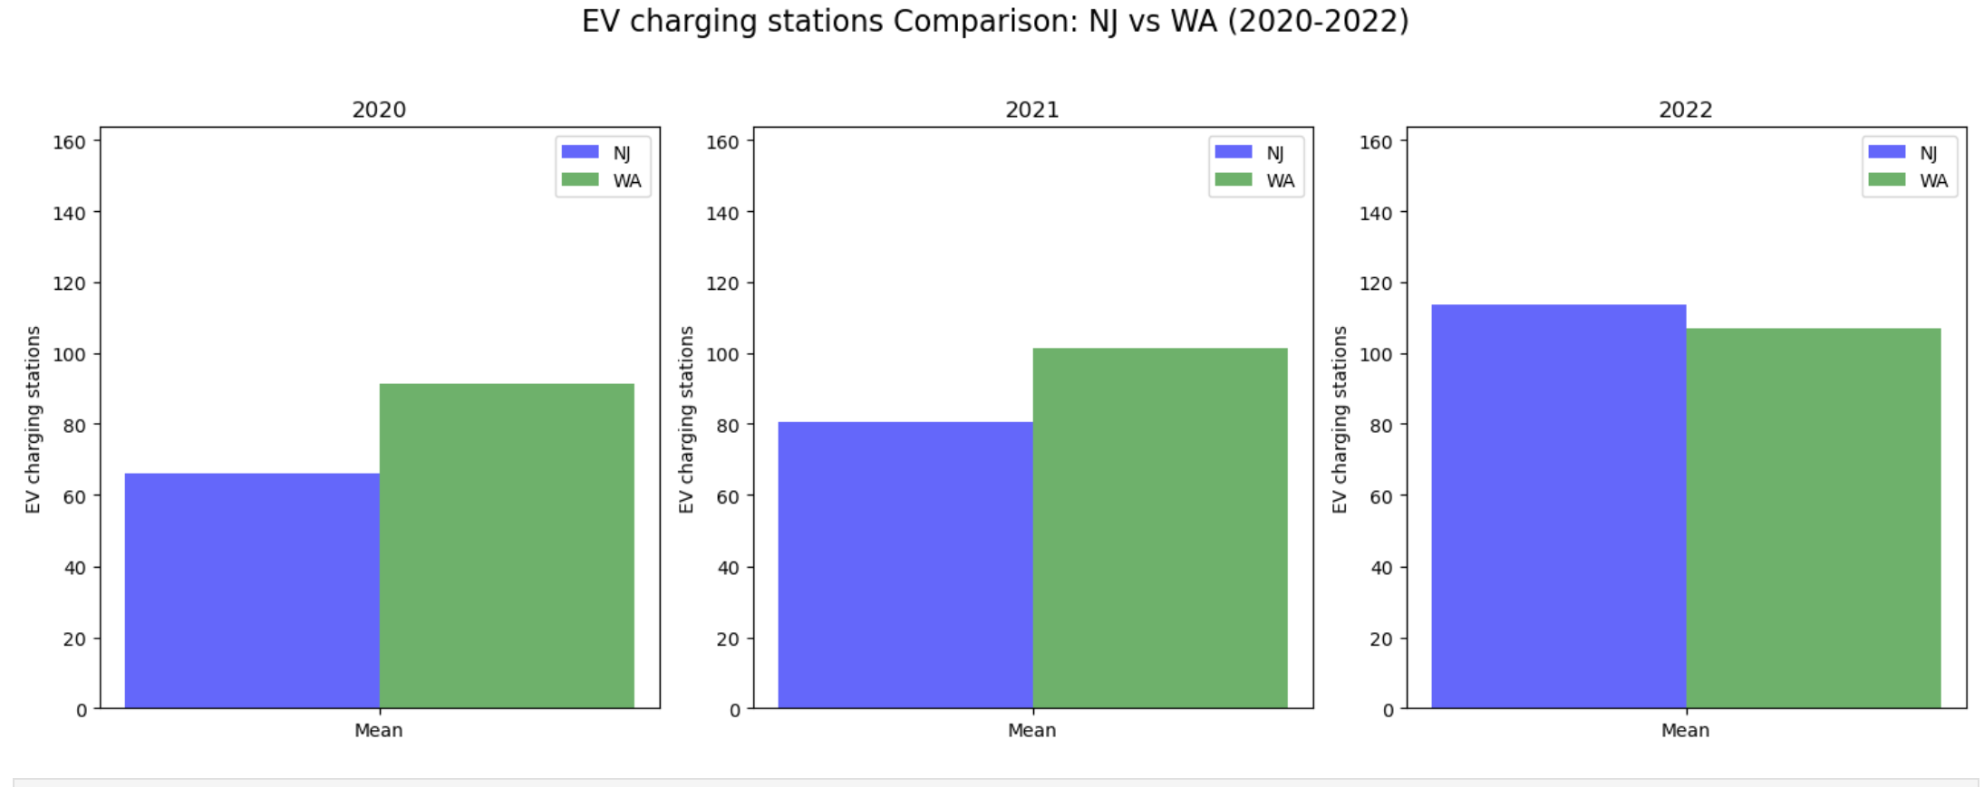
Comparing WA and NJ: NEW EV Registered and Charging Stations

Slide 9
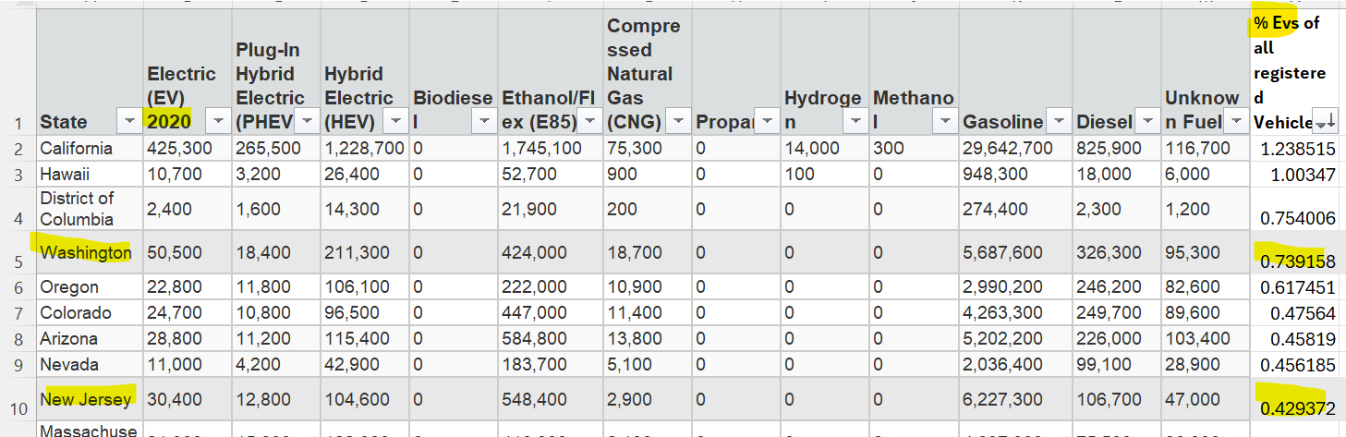
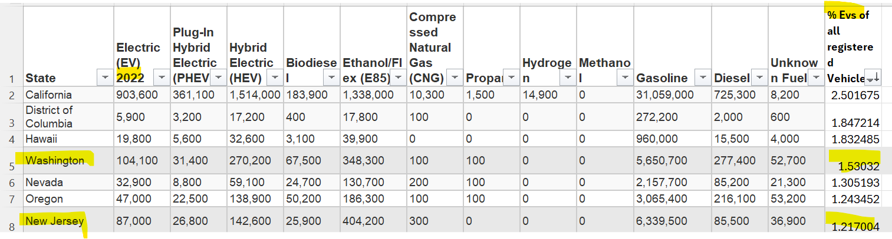
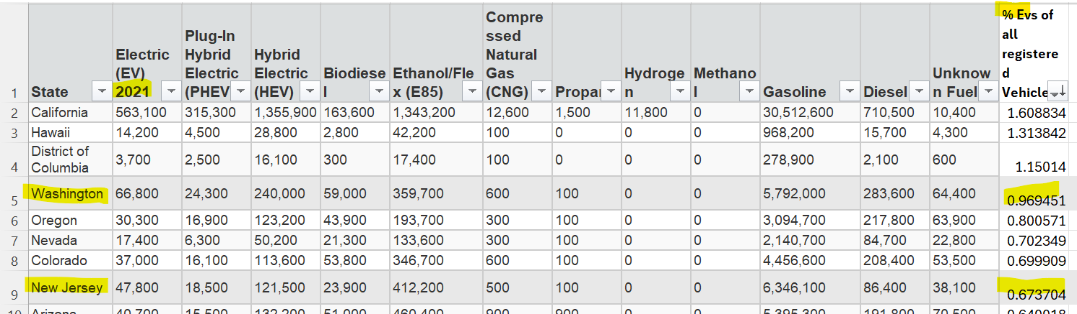
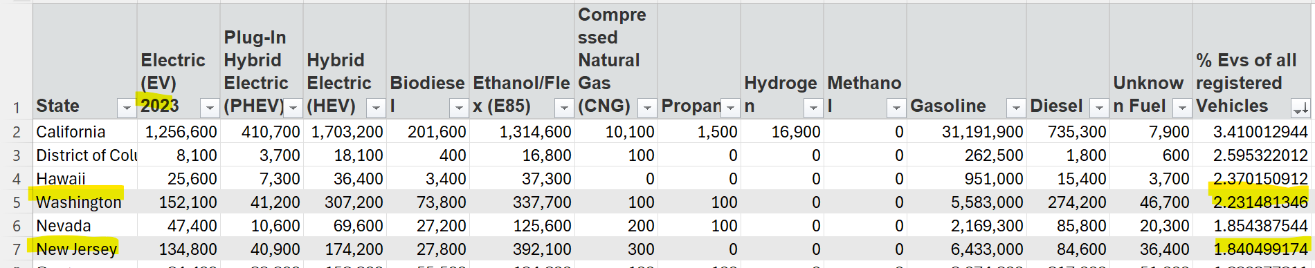
State Wise Comparison - % EVs Of All Registered Vehicles 2020 to 2023
2020
2022
2021
2023
https://afdc.energy.gov/data_download?download[data][api]=alt_fuel_stations&download[data][timeframe]=historical

Slide 10
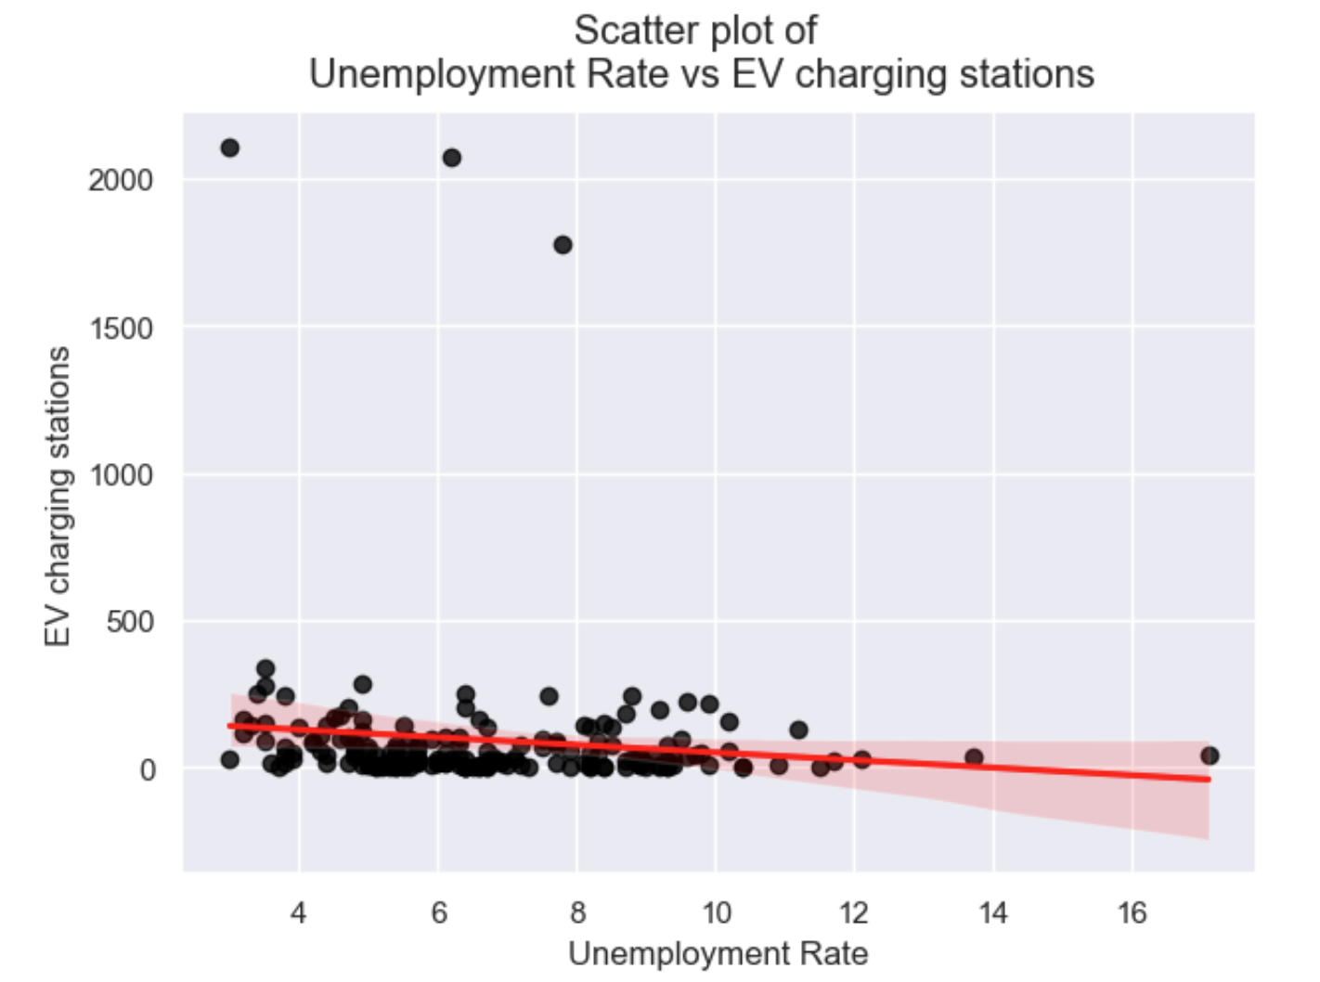
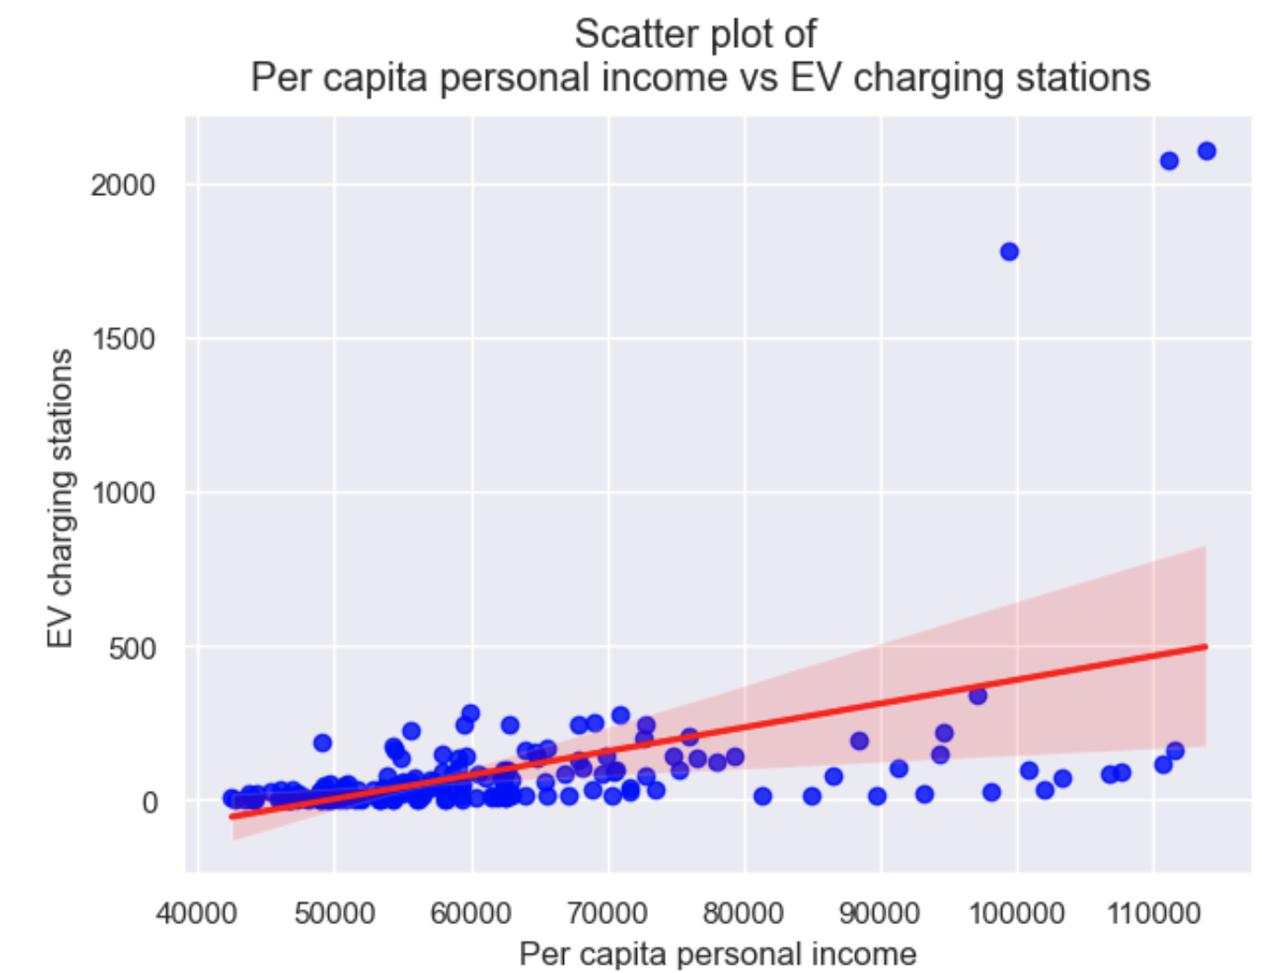
Scatter Plot

Slide 11
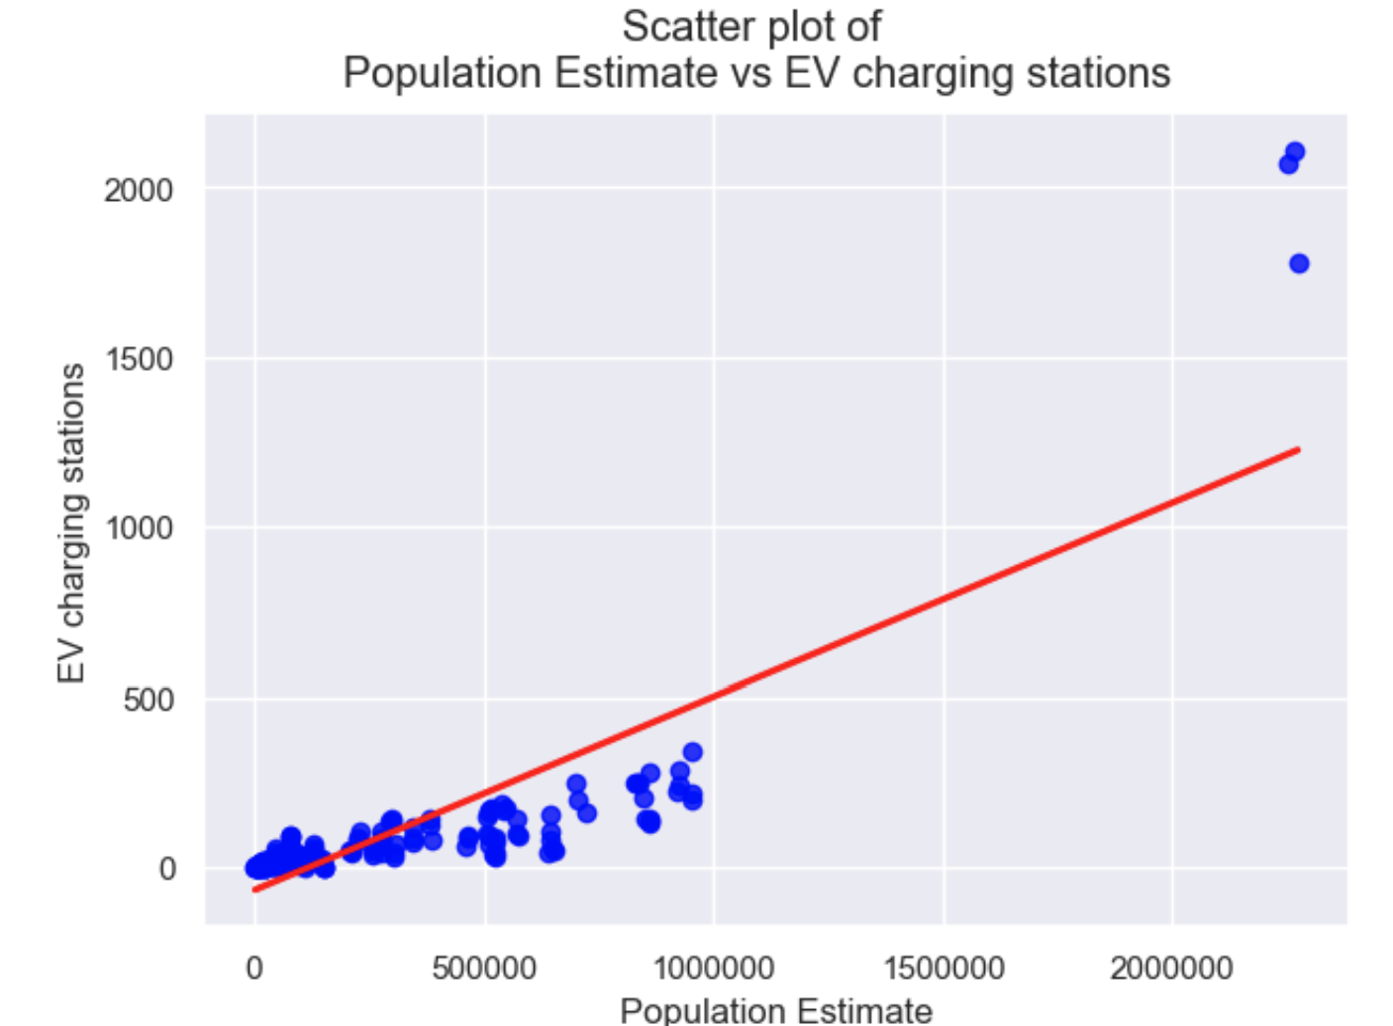
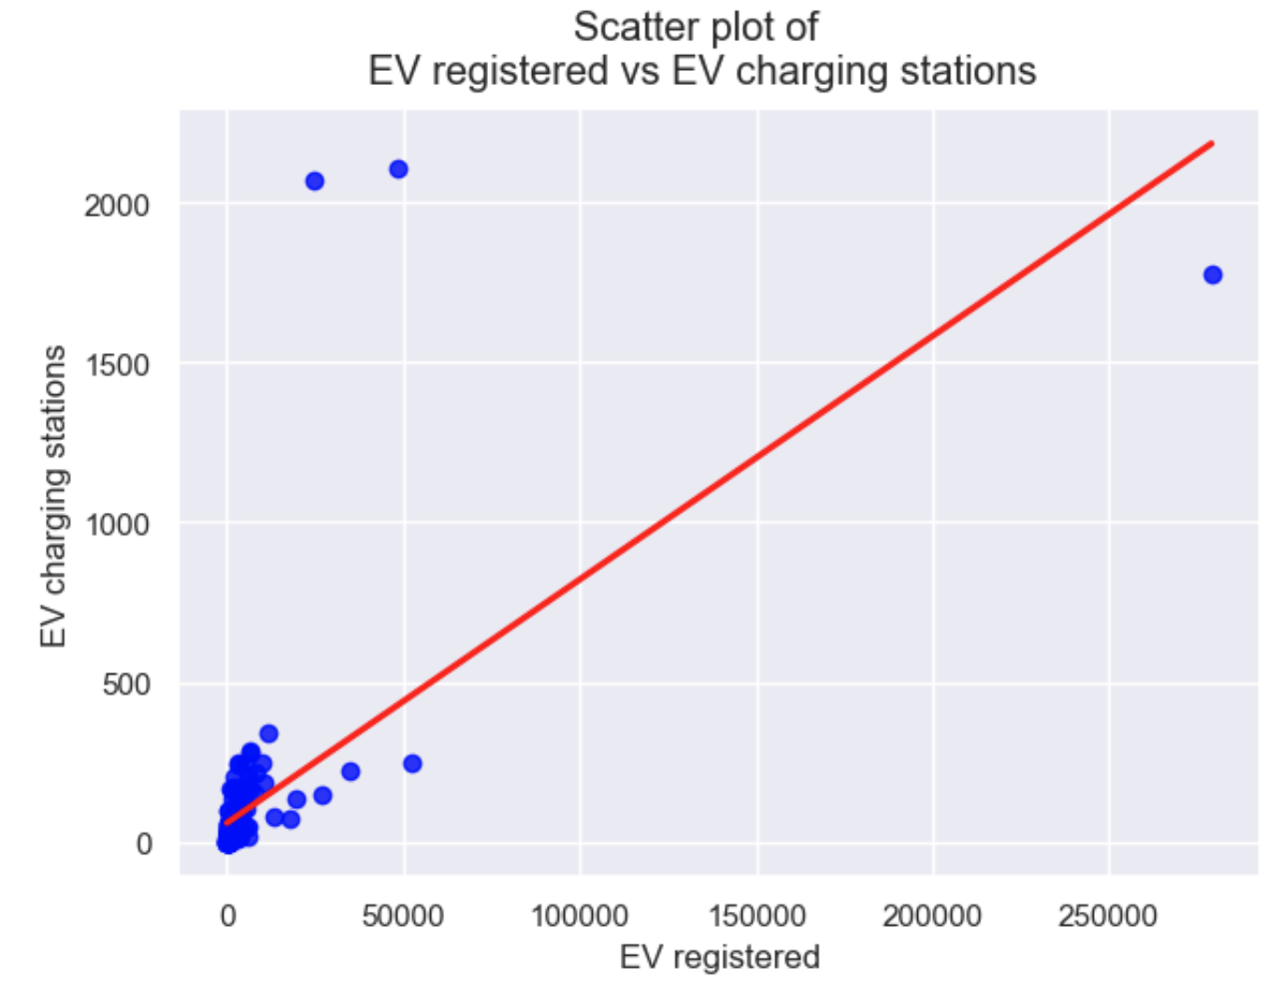
Scatter Plot

Slide 12
Analytical Methods & Validation Techniques
Continuous data --Supervised machine learning algorithm, OLS (ordinary least square), provides the linear relationship between the socio-economic factors
For model forecasting, the dataset is divided into two subsets: a training set and a testing set, using an 80/20 split.

Slide 13
MSE (Mean Squared Error) and RMSE (Root Mean Squared Error) valueS
Model's Performance:
KFold MSE train: 97704.880349 > KFold MSE test: 854.920559
KFold RMSE train : 312.577799 > KFold RMSE test: 29.239025
OLS MSE train: 2216372.524527 > OLS MSE test: 7891.039539
OLS RMSE train: 1488.748644 > OLS RMSE test: 88.831523

Slide 14
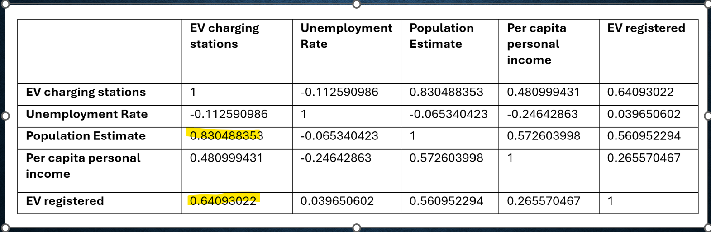
Correlation Matrix

Slide 15
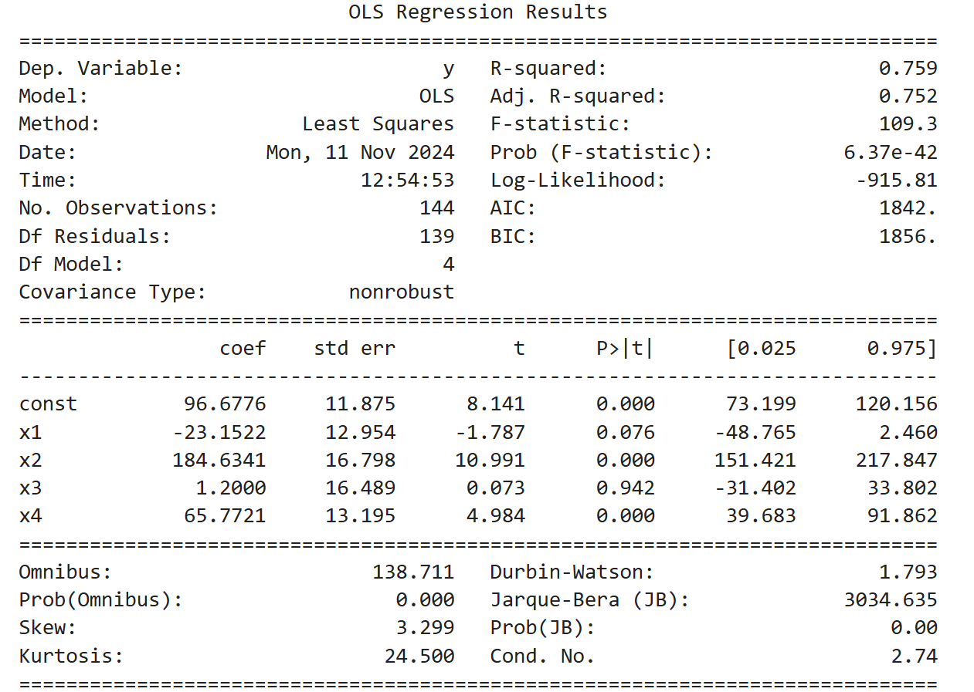
Model Equation
Y = 96.6776 – 23.1522 ⋅ x1 + 184.6341 ⋅ x2 + 1.2000 ⋅ x3 + 65.7721 ⋅ x4
Where,
x1= Unemployment Rate,
x2 = population Estimate,
x3 =Per capita personal income,
x4 = EV registered
96.6776 is a constant value.

Slide 16
Discussion & Conclusion
EV population and county population density have strong positive relationships with the presence of charging stations, while unemployment rates and per capita income are less influential.
The model explains about 76% of the variance in the DV, which is a good fit.
The large F-statistic value (109.3) and its p-value (6.37e-42) show that the model is statistically significant and explains a substantial portion of the variability in the dependent variable.
With a low p-value (almost zero), the null hypothesis is rejected, and the model provides meaningful insights.
Future application --Understanding socio-economic dynamics is vital for creating sustainable and effective policies that support the growth of EV infrastructure
Limitation – Research can be extended by including counties from other US States, geographic scope, the chosen variables, potential model assumptions

Slide 17
Thank you!

